Slide 1
Practicum in Neuroimage Analysis
BIOENG 2195 Spring 2025
Unveiling the Black Box: Explainable AI in Medical Imaging
Ganesh Puthiaraju

Slide 2
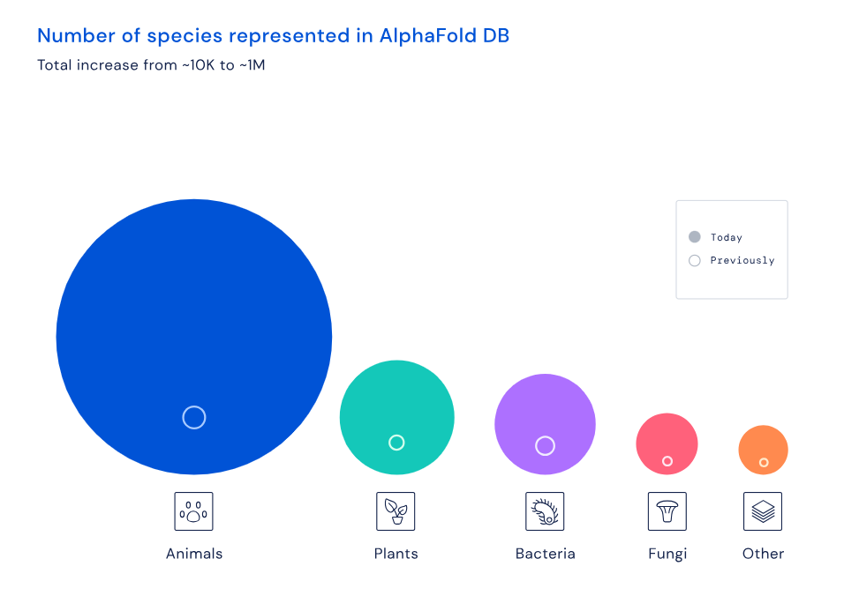
A Glimpse of AI Achievements in Recent Years
Protein Structure Prediction
AlphaFold2 (2020) predicted protein structures with atomic-level accuracy, solving a 50-year grand challenge​
[Reference: Jumper, J., et al. (2021). Highly accurate protein structure prediction with AlphaFold. Nature, 596(7873), 583-589.]

Slide 3
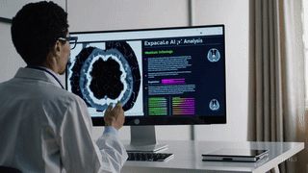

A Glimpse of AI Achievements in Recent Years
Conversational and Generative AI
Large Language Models (ChatGPT o1, Claude Sonnet 3.7, Google Gemini Pro 2.0): Demonstrating advanced reasoning and conversational abilities.
Generative AI (DALL-E 2, Stable Diffusion): Creating realistic images from text descriptions.
- Sora
[Reference: Ramesh, A., et al. (2022). Hierarchical text-conditional image generation with CLIP latents. arXiv preprint arXiv:2204.06125.]

Slide 4
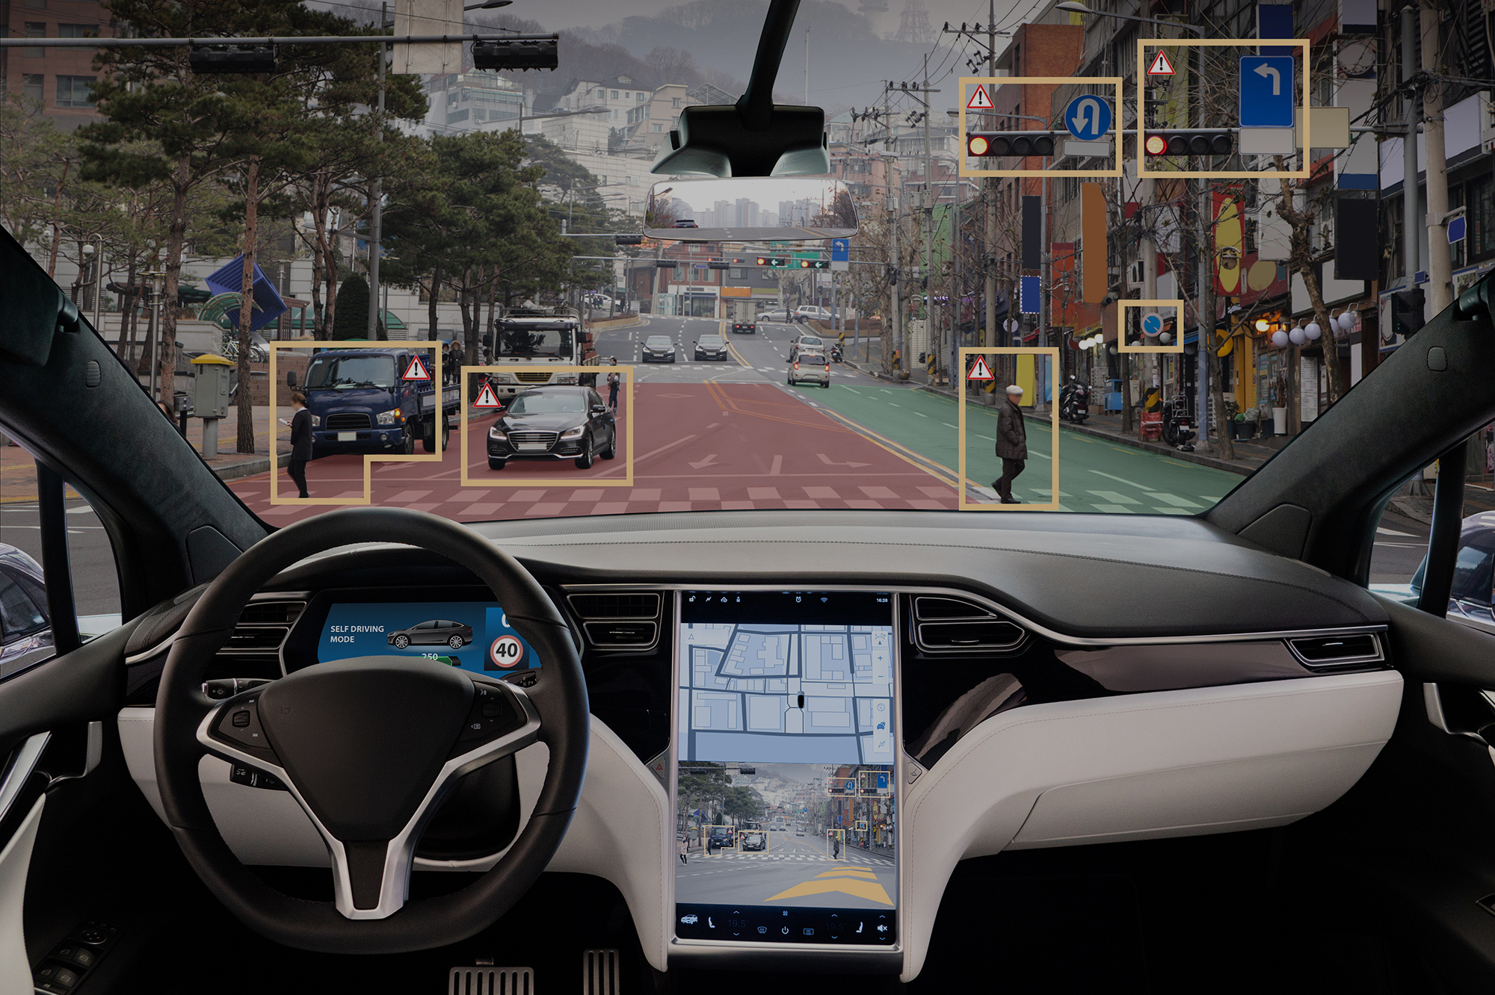
A Glimpse of AI Achievements in Recent Years
Autonomous Systems
Self-driving cars (Waymo, Tesla prototypes) navigate safely in test environments due to advances in perception and planning.
[Reference: End-to-End Deep Learning for Self-Driving Cars by Bojarski et al. from NVIDIA Research (2016)]

Slide 5
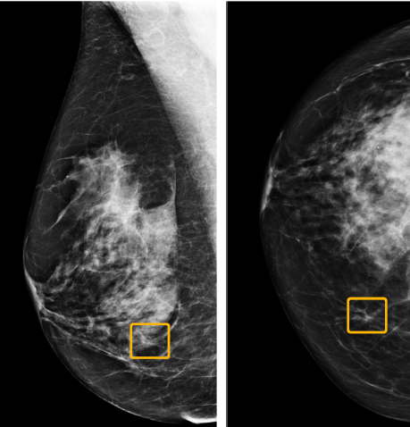
A Glimpse of AI Achievements in Medical Imaging
Expert-Level Diagnosis: CNNs and Transformers detect conditions like diabetic retinopathy and lung nodules with radiologist-level accuracy
Image Segmentation: Automated delineation of organs and tumors improving surgical planning and treatment
Computer-Aided Detection: AI screening systems for mammograms and X-rays reduce missed abnormalities
Prognostic Models: Networks combining imaging with clinical data predict disease progression trajectories
Workflow Optimization: AI triage prioritizes urgent cases, accelerating treatment for critical patients
[Reference: McKinney SM, Sieniek M, Godbole V, et al. International evaluation of an AI system for breast cancer screening. Nature. 2020;577(7788):89-94.]

Slide 6

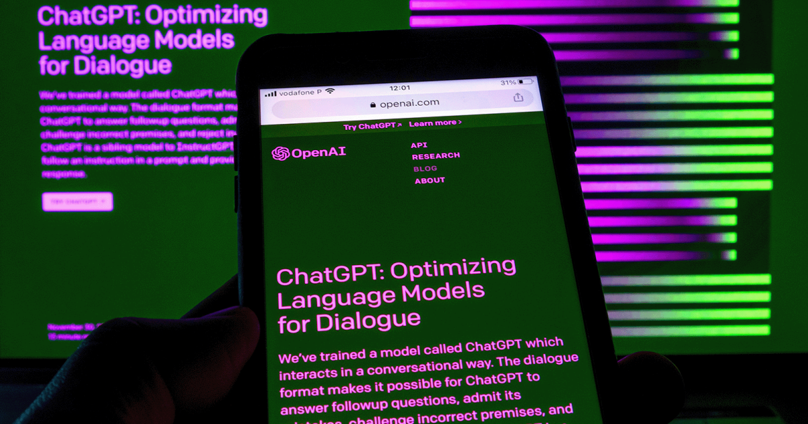
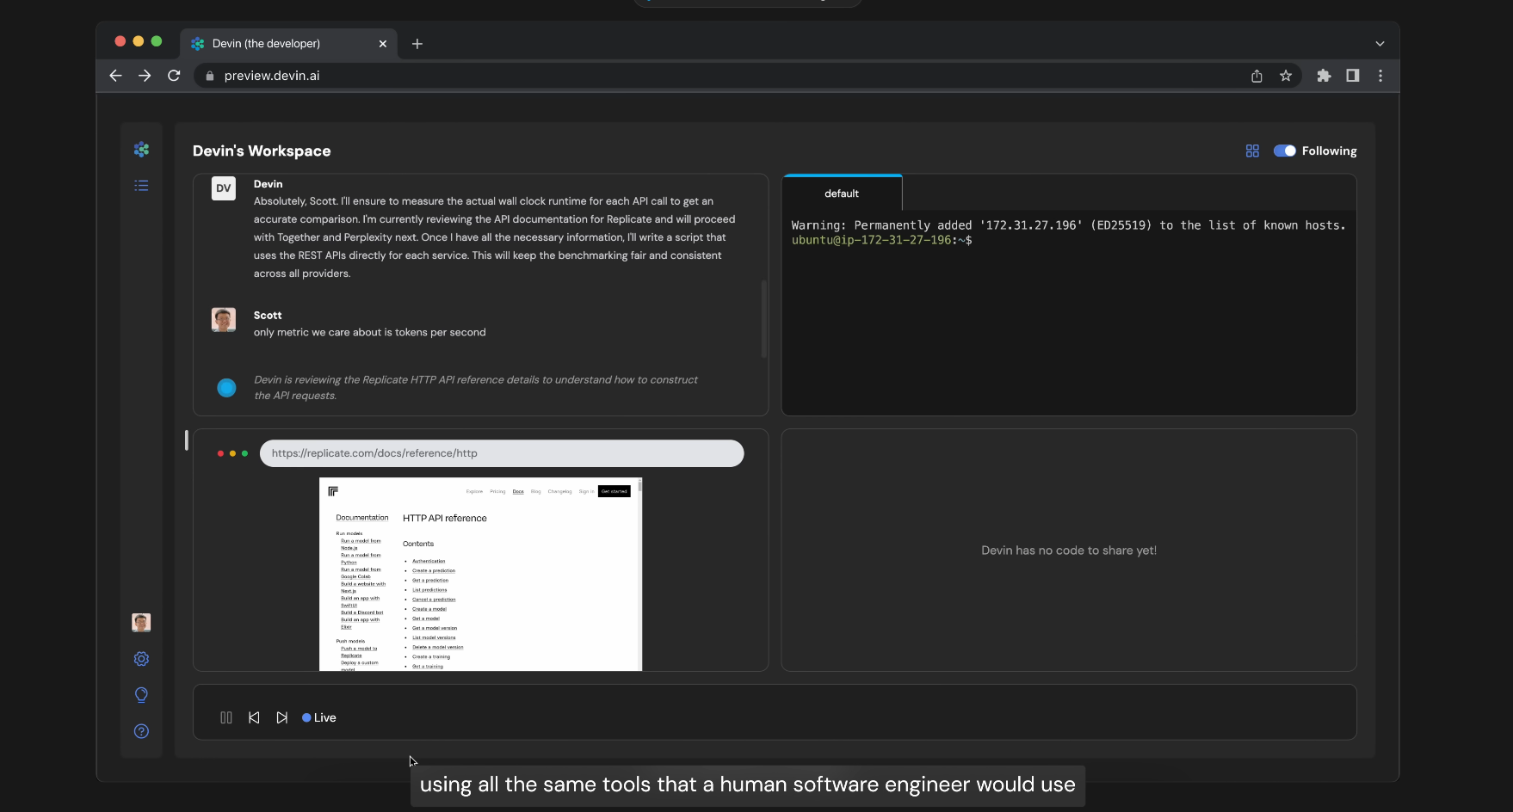

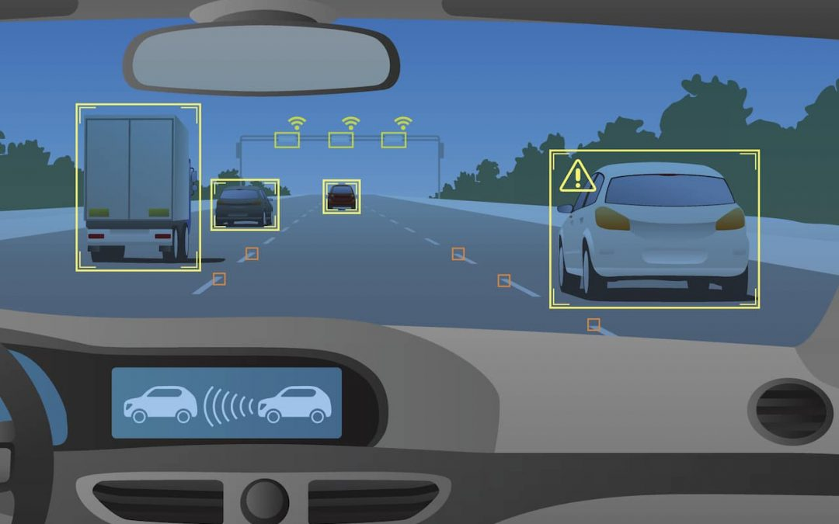
AI works …

Slide 7
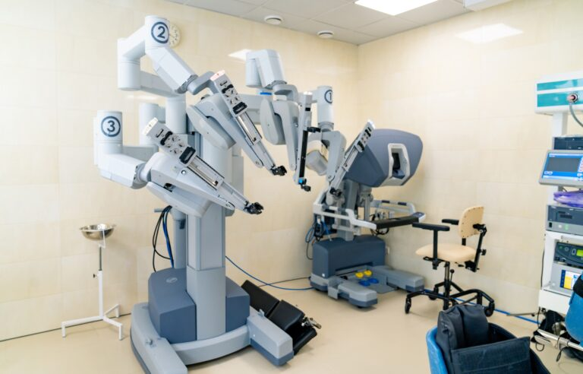

AI works. But is it reliable, interpretable, and robust ?

Slide 8
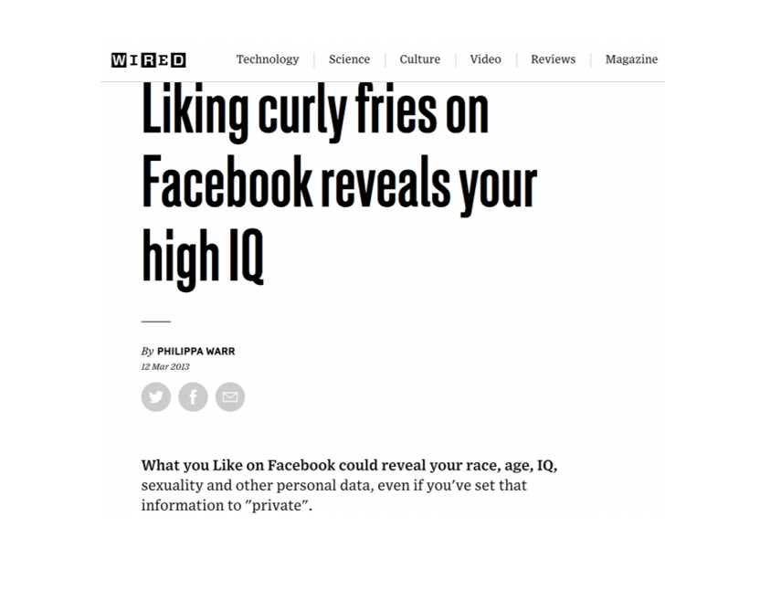
XAI: Explainability in AI
We do not want models to fail when they get in the real world.

Slide 9
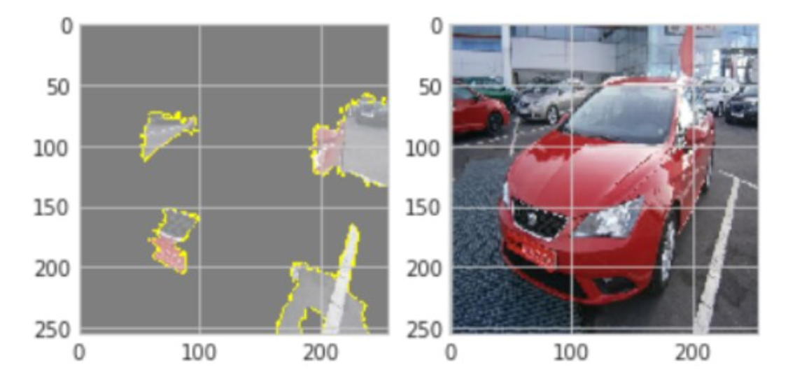
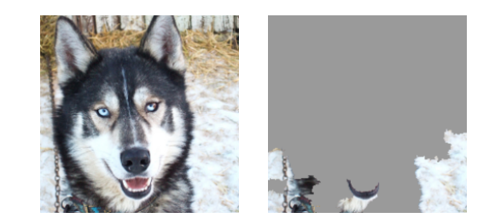
XAI: Explainability in AI
Without explainability, we might deploy models that make decisions for the wrong reasons
Explanation Failure: Model classifies vehicle based on background context rather than car features
Misleading Correlation: Husky misclassified as wolf based on snowy background rather than animal features

Slide 10
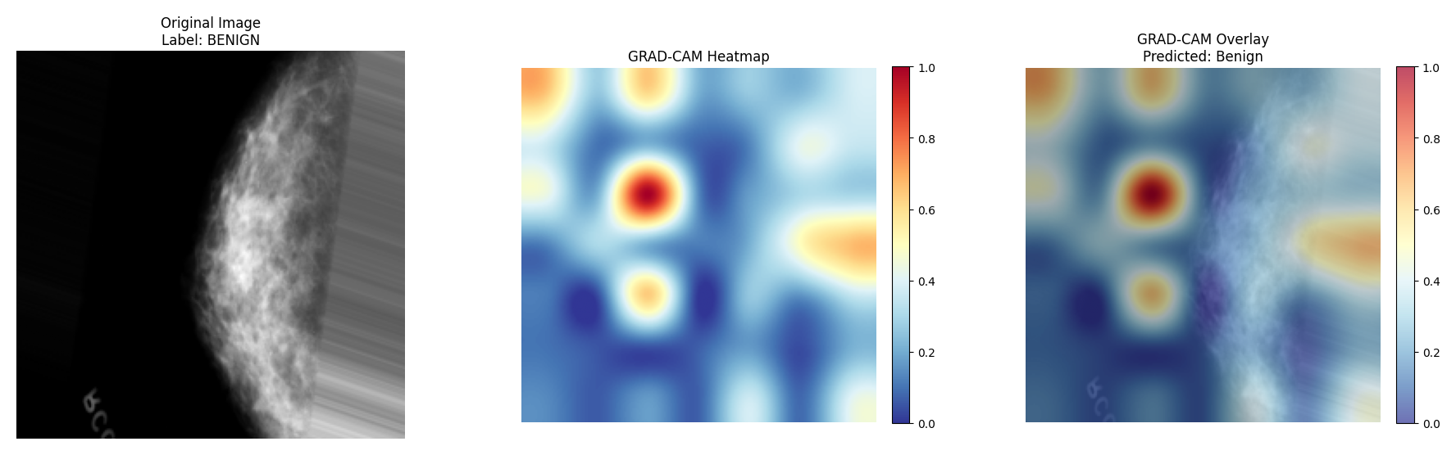
XAI: Explainability in AI
Model classifies mammogram as benign by focusing on image background rather than breast tissue features

Slide 11
Why Explainability Matters?
Explainability in AI shines as a guiding light,
In medical imaging, it clarifies what's right.
For High Stakes Decisions, we need unshaken ground—
Where Trust and Adoption in clear truth is found.
Through Debugging and Improvement, each flaw is laid bare,
And Regulatory Compliance ensures that rules are fair.
Above all, Ethical Considerations keep conscience at the core—
These reasons define why explainability matters evermore.
High-Stakes Decisions
Trust and Adoption
Debugging and Improvement
Regulatory Compliance
Ethical Responsibility

Slide 12
Why Explainability Matters?
Explainability in AI shines as a guiding light,
In medical imaging, it clarifies what's right.
For High Stakes Decisions, we need unshaken ground—
Where Trust and Adoption in clear truth is found.
Through Debugging and Improvement, each flaw is laid bare,
And Regulatory Compliance ensures that rules are fair.
Above all, Ethical Considerations keep conscience at the core—
These reasons define why explainability matters evermore.
High-Stakes Decisions
Trust and Adoption
Debugging and Improvement
Regulatory Compliance
Ethical Responsibility
- ChatGPT o1

Slide 13
Types of Explainability
Intrinsic vs. Post-hoc
Local vs. Global
Model-Agnostic vs. Model-Specific

Slide 14
Intrinsic vs. Post-hoc
Intrinsic: Models designed to be inherently interpretable (e.g., decision trees, linear models).
Post-hoc: Techniques applied after a model is trained to explain its predictions.

Slide 15
Local vs. Global
Local: Explaining individual predictions (e.g., "Why did the model classify this image as malignant?").
Global: Understanding the overall behavior of the model (e.g., "What features are most important overall?").

Slide 16
Model-Agnostic vs. Model-Specific
Model-Agnostic: Methods that can be applied to any model (e.g., LIME, SHAP).
Model-Specific: Methods designed for specific model architectures (e.g., Grad-CAM for CNNs).

Slide 17
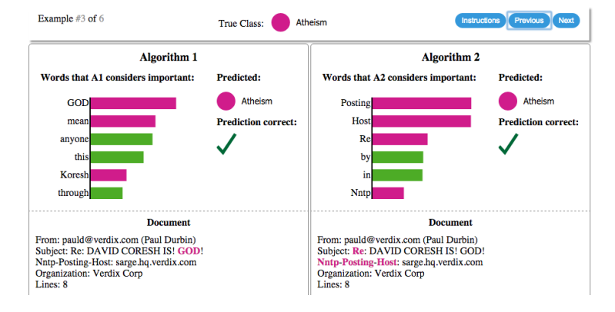
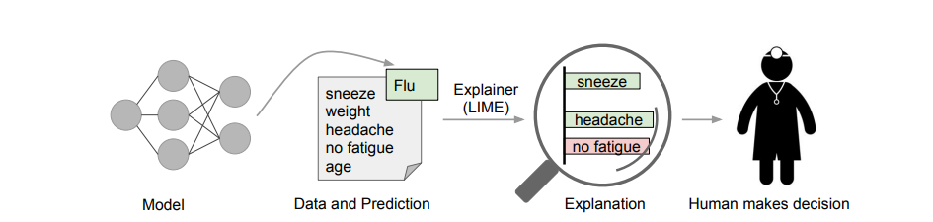
Explaining Predictions with LIME
Local Interpretable Model-Agnostic Explanations – is a technique introduced by to explain individual predictions of any classifier​. The core idea is to approximate the model locally with a simpler interpretable model. Think of it as “peeking inside the black box, one prediction at a time” by asking “what happens if we tweak this input slightly?”​

Slide 18
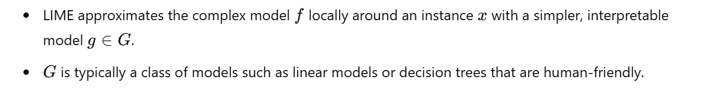
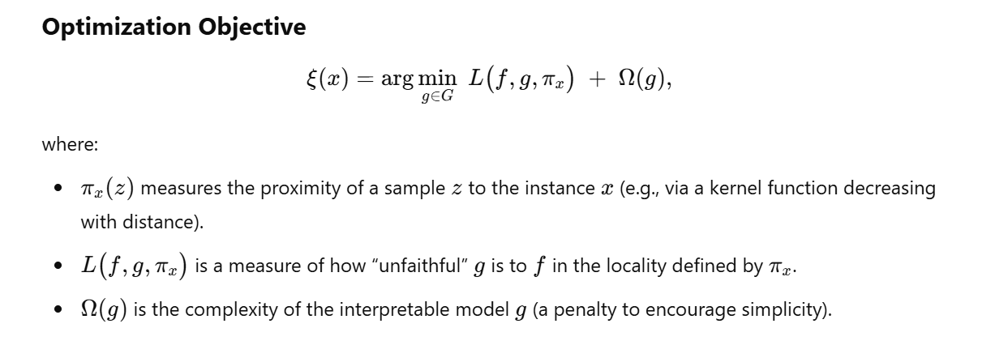
Explaining Predictions with LIME

Slide 19
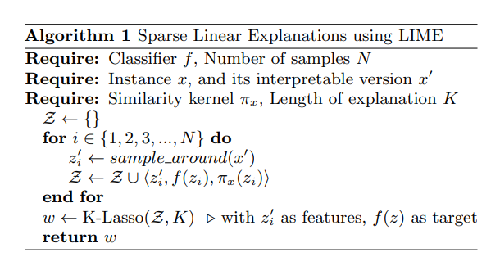
LIME: Explaining Predictions with Local Linear Approximations
Perturb
Predict
Weight
Fit
Explain
[Reference: Ribeiro, M. T., Singh, S., & Guestrin, C. (2016). "Why should I trust you?" Explaining the predictions of any classifier. Proceedings of the 22nd ACM SIGKDD international conference on knowledge discovery and data mining, 1135-1144.]

Slide 20
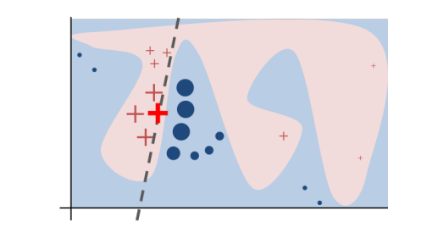
LIME: Explaining Predictions with Local Linear Approximations
Perturb
Predict
Weight
Fit
Explain

Slide 21
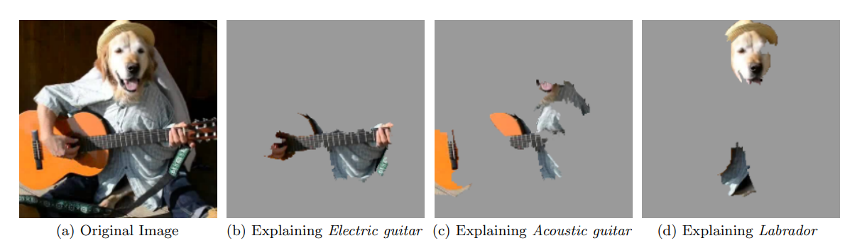
Explaining Predictions with LIME
Superpixels: Groups of similar, adjacent pixels forming coherent image regions (e.g., tissue areas in medical scans)

Slide 22
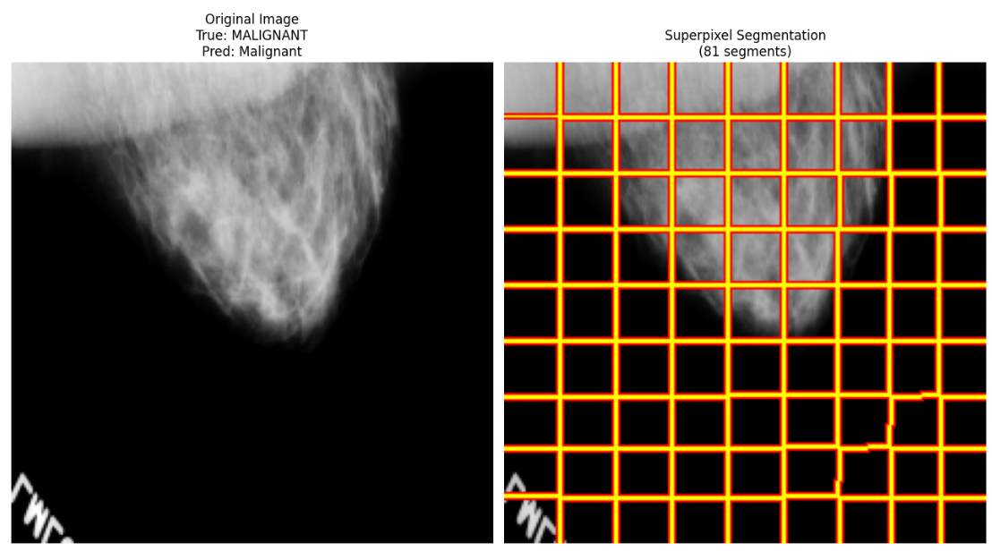
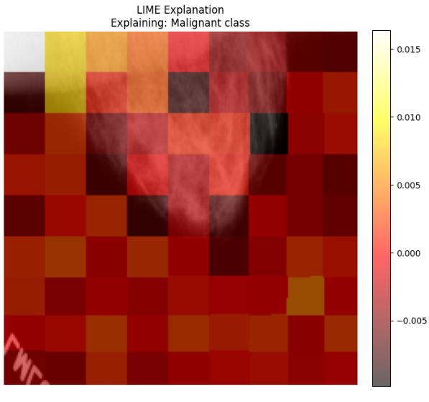
Explaining Predictions with LIME
Superpixels: Groups of similar, adjacent pixels forming coherent image regions (e.g., tissue areas in medical scans)

Slide 23
LIME: Pros and Cons
Advantages:
Model-agnostic: Works with any black-box model.
Local explanations: Provides insights into individual predictions.
Relatively easy to understand and implement.
Limitations:
Instability: Explanations can vary depending on the perturbation strategy and the choice of the local model.
Linearity Assumption: May not accurately capture complex, non-linear relationships.
Defining "Locality": Choosing the right neighborhood size can be challenging.
Computational Cost: Can be computationally expensive for high-dimensional data.

Slide 24
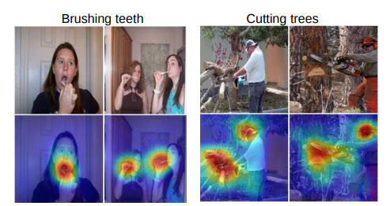
Class Activation Map (CAM)
A Class Activation Map for a category highlights discriminative image regions used by a CNN to identify that category.
[Reference: B. Zhou, A. Khosla, A. Lapedriza, A. Oliva, and A. Torralba, Learning Deep Features for Discriminative Localization, CVPR 2016.]

Slide 25
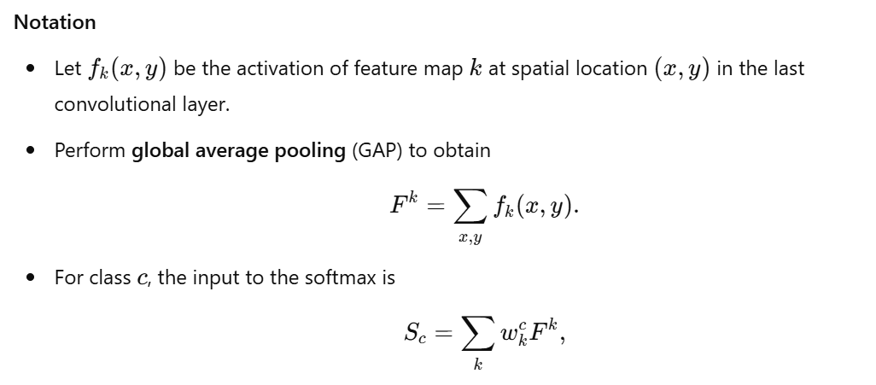
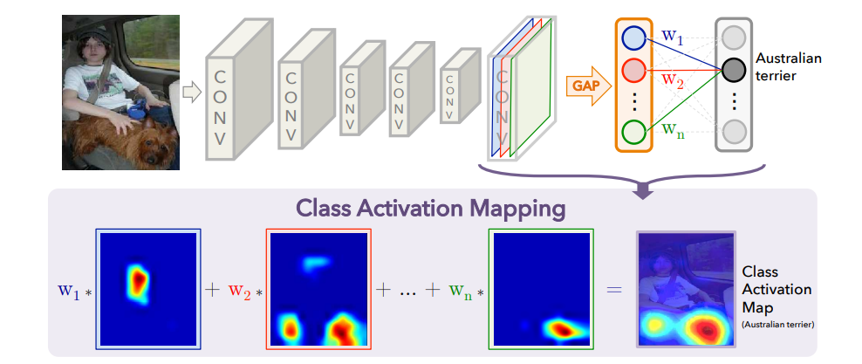
Class Activation Map (CAM)

Slide 26
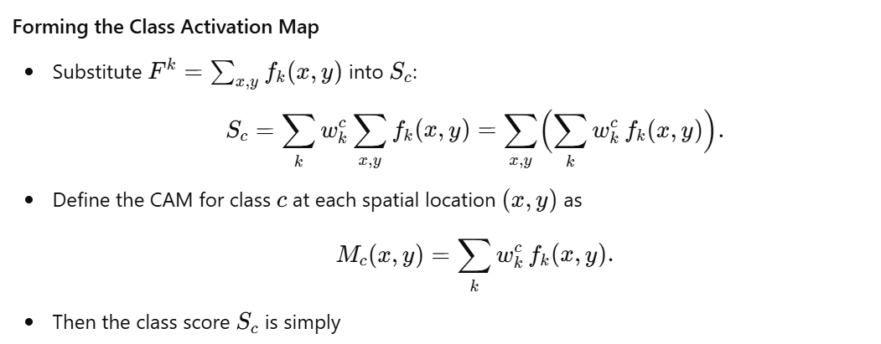
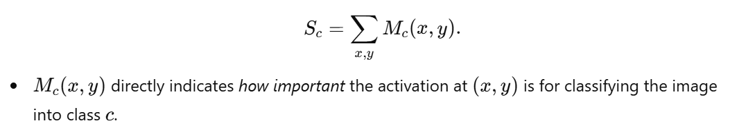
Class Activation Map (CAM)

Slide 27
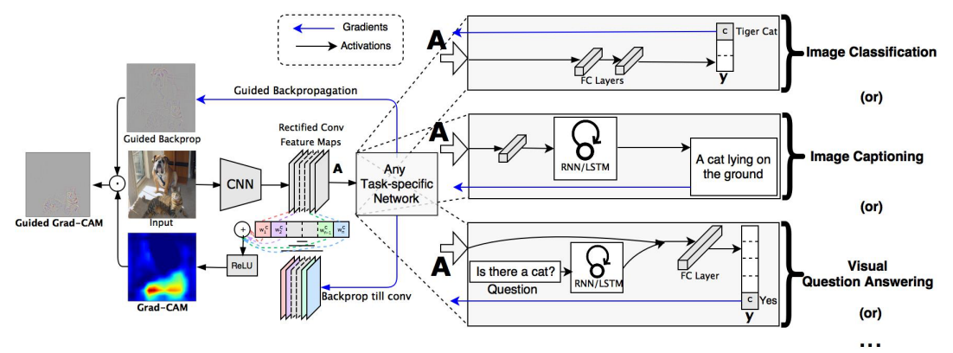
Grad-CAM: Visual Explanations for CNNs
Gradient-weighted Class Activation Mapping (Grad-CAM) produces a heatmap over the input image, highlighting which regions were most influential for a given class prediction

Slide 28

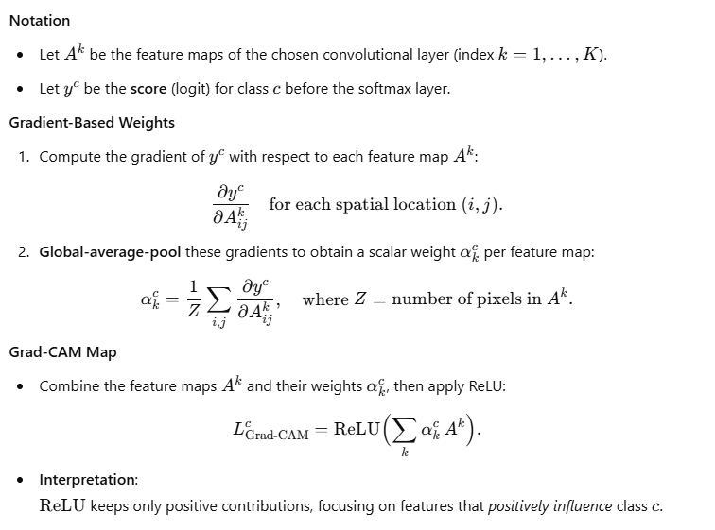
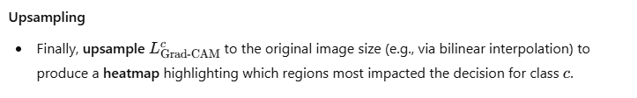
Grad-CAM: Mathematical Formulation

Slide 29
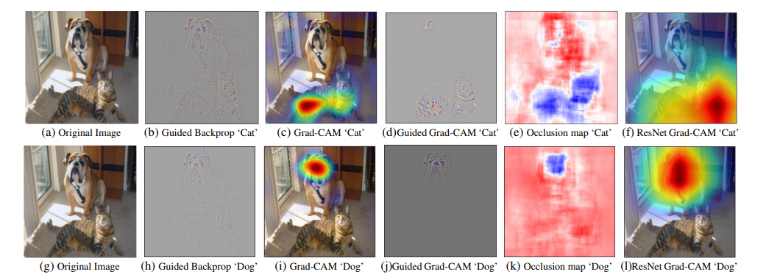
Grad-CAM: Visual Explanations for CNNs
When dealing with convolutional neural networks (CNNs) on images (like most medical image models), Grad-CAM is a go-to XAI method.

Slide 30
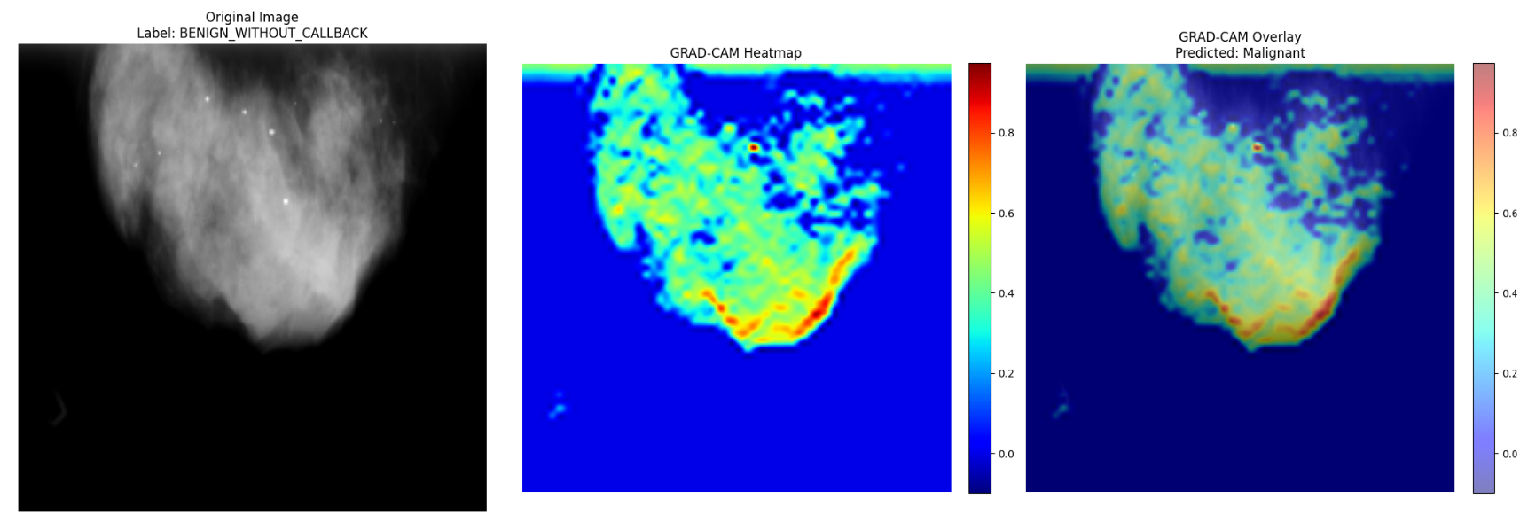
Grad-CAM: Visual Explanations for CNNs

Slide 31
Grad-CAM
Forward Pass: Pass the input image through the CNN.
Compute Gradients: Calculate the gradients of the class score (e.g., “Benign") with respect to the feature maps of a chosen convolutional layer (usually the last one).
Global Average Pooling: Average the gradients across each feature map to obtain "neuron importance weights."
Weighted Combination: Multiply each feature map by its corresponding weight and sum them up.
ReLU: Apply a ReLU activation to keep only positive contributions (features that positively influence the class).
Upsample: Upsample the resulting heatmap to the size of the input image.
[Reference: Selvaraju, R. R., Cogswell, M., Das, A., Vedantam, R., Parikh, D., & Batra, D. (2017). Grad-CAM: Visual explanations from deep networks via gradient-based localization. Proceedings of the IEEE international conference on computer vision, 618-626.]

Slide 32
Grad-CAM
Advantages:
Visual Explanations: Provides intuitive heatmaps that highlight important regions.
Model-Specific (CNNs): Well-suited for convolutional neural networks, leveraging their architecture.
Relatively Simple: Easy to implement and computationally efficient.
Limitations:
Coarse Localization: Heatmaps can be low-resolution and may not precisely pinpoint the exact boundaries of relevant regions.
Layer Choice: The choice of the convolutional layer can affect the results.
Gradient Saturation: Gradients can saturate, leading to less informative heatmaps.

Slide 33
Guided Grad-CAM =
Guided Backpropagation + Grad-CAM
Combines Grad-CAM with Guided Backpropagation to produce higher-resolution, more detailed visualizations.

Slide 34
Guided Grad-CAM =
Guided Backpropagation + Grad-CAM
Combines Grad-CAM with Guided Backpropagation to produce higher-resolution, more detailed visualizations.
Guided Backpropagation: A modified backpropagation algorithm that only propagates positive gradients, highlighting features that positively contribute to the activation of a neuron.
Combination: Element-wise multiplication of the Grad-CAM heatmap and the Guided Backpropagation output.

Slide 35
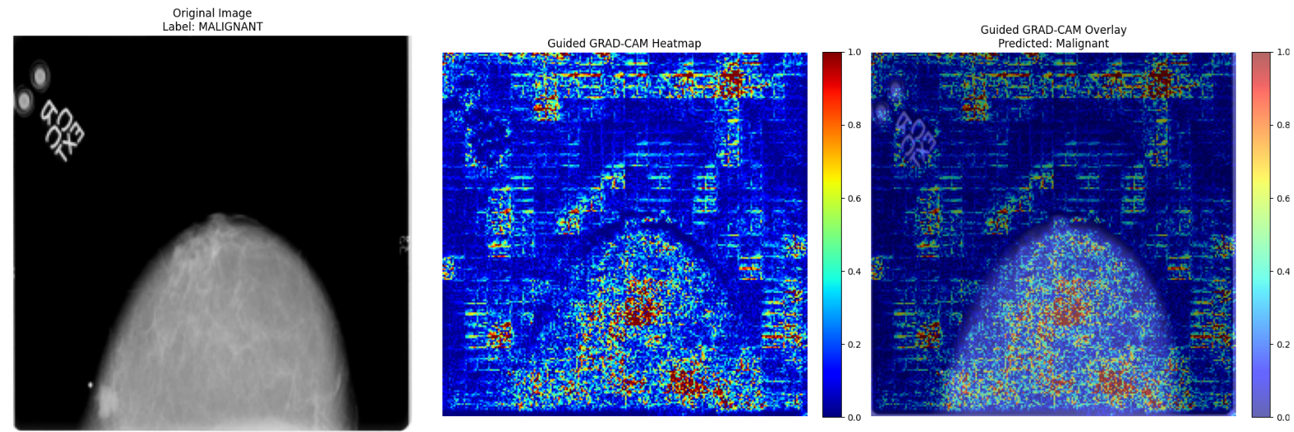
Guided Grad-CAM = Guided Backpropagation + Grad-CAM

Slide 36
SmoothGrad
Problem: Gradient-based methods (like Grad-CAM) can be sensitive to noise in the input image, leading to noisy explanations.
Solution: SmoothGrad averages the explanations obtained from multiple noisy versions of the input image.
Note: SmoothGrad requires multiple forward-backward passes, so it’s a bit more computational work for a cleaner visualization.

Slide 37
SmoothGrad
Steps:
Add small amounts of Gaussian noise to the input image multiple times.
Compute the explanation (e.g., Grad-CAM, Guided Backpropagation) for each noisy image.
Average the explanations to obtain a smoother, more robust explanation.

Slide 38
SmoothGrad
Steps:
Add small amounts of Gaussian noise to the input image multiple times.
Compute the explanation (e.g., Grad-CAM, Guided Backpropagation) for each noisy image.
Average the explanations to obtain a smoother, more robust explanation.
[Reference: Smilkov, D., Thorat, N., Kim, B., Viégas, F., & Wattenberg, M. (2017). Smoothgrad: removing noise by adding noise. arXiv preprint arXiv:1706.03825.]

Slide 39
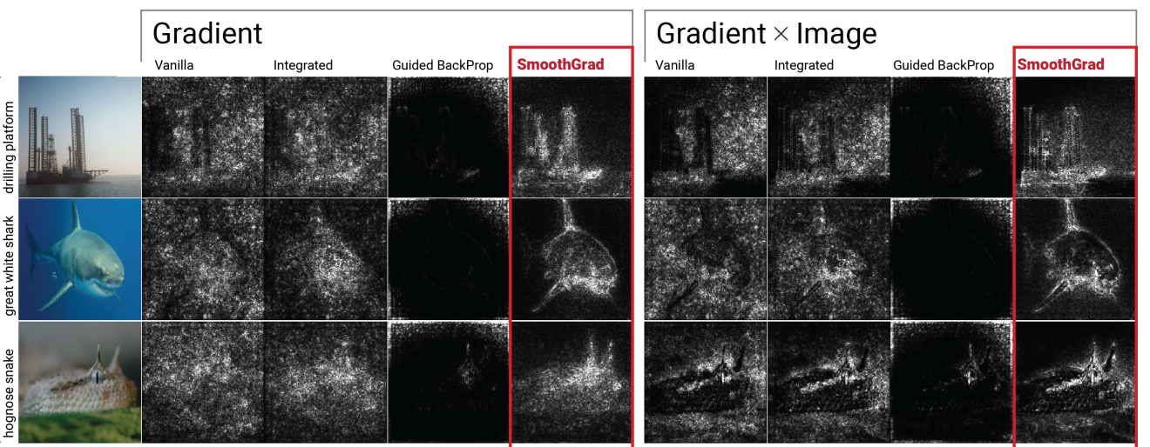
SmoothGrad

Slide 40
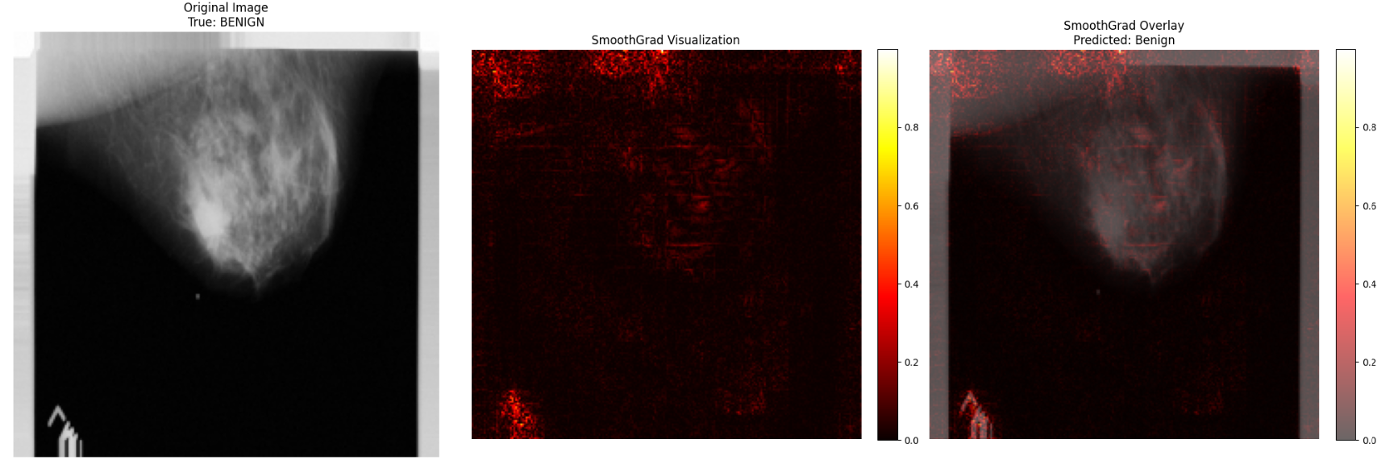
SmoothGrad

Slide 41
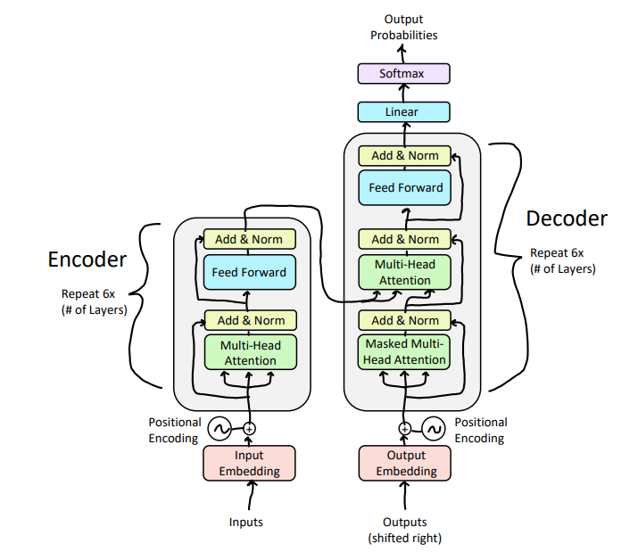
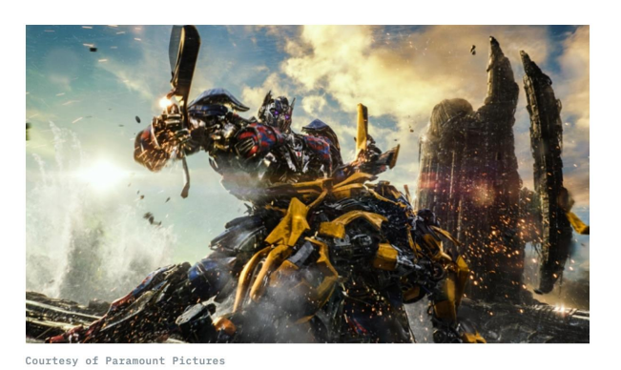
Introduction to Transformers

Slide 42
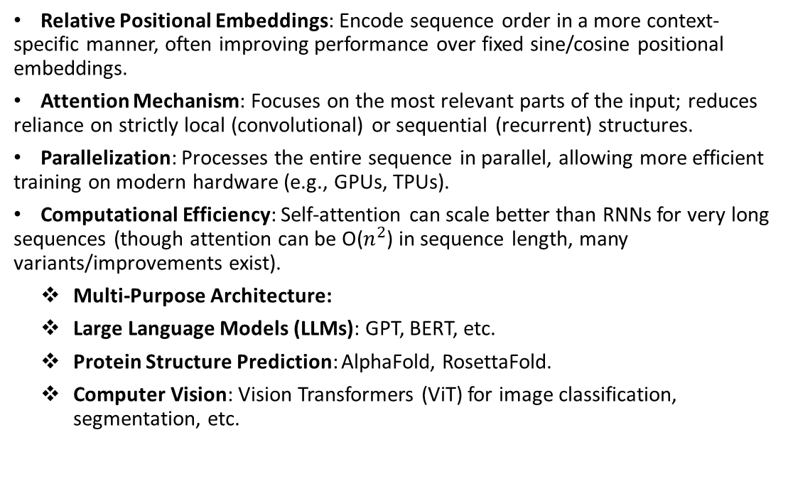
Introduction to Transformers
Relative Positional Embeddings: Encode sequence order in a more context-specific manner, often improving performance over fixed sine/cosine positional embeddings.
Attention Mechanism: Focuses on the most relevant parts of the input; reduces reliance on strictly local (convolutional) or sequential (recurrent) structures.
Parallelization: Processes the entire sequence in parallel, allowing more efficient training on modern hardware (e.g., GPUs, TPUs).
Computational Efficiency: Self-attention can scale better than RNNs for very long sequences (though attention can be O($n^{2}$) in sequence length, many variants/improvements exist).
Multi-Purpose Architecture:
Large Language Models (LLMs): GPT, BERT, etc.
Protein Structure Prediction: AlphaFold, RosettaFold.
Computer Vision: Vision Transformers (ViT) for image classification, segmentation, etc.

Slide 43
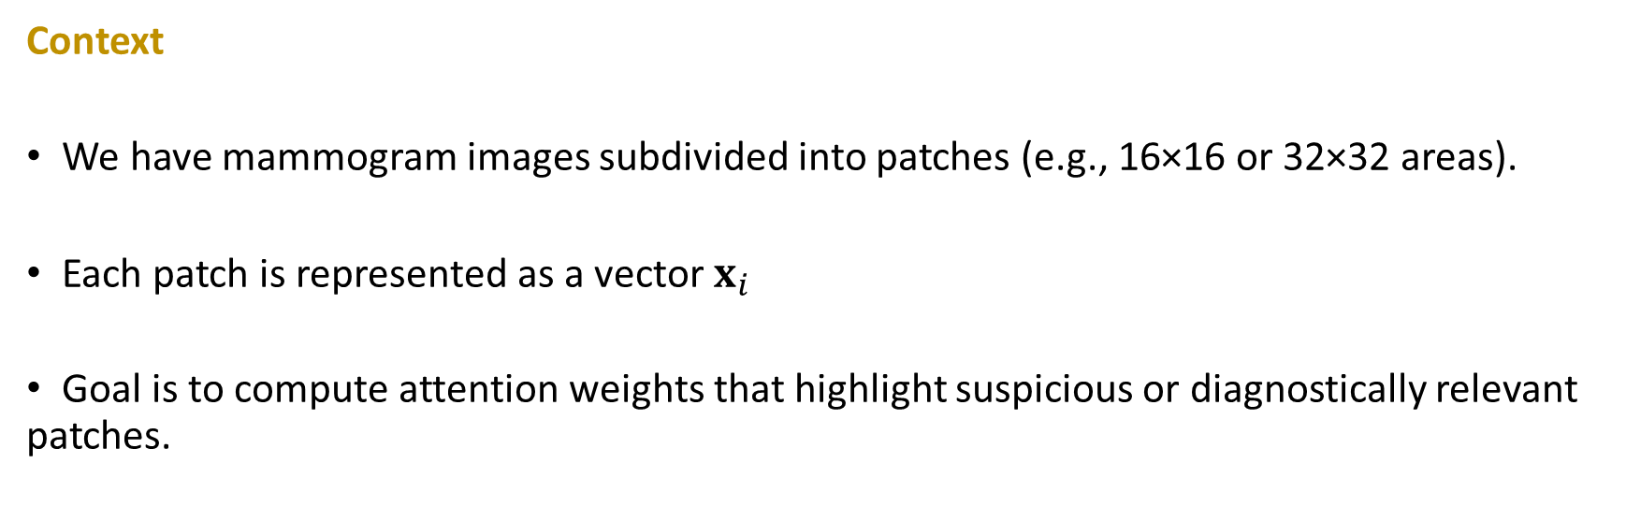
Mathematical View of Attention in Mammogram Patch Analysis
Context
We have mammogram images subdivided into patches (e.g., 16×16 or 32×32 areas).
Each patch is represented as a vector $x_{i}$
Goal is to compute attention weights that highlight suspicious or diagnostically relevant patches.

Slide 44

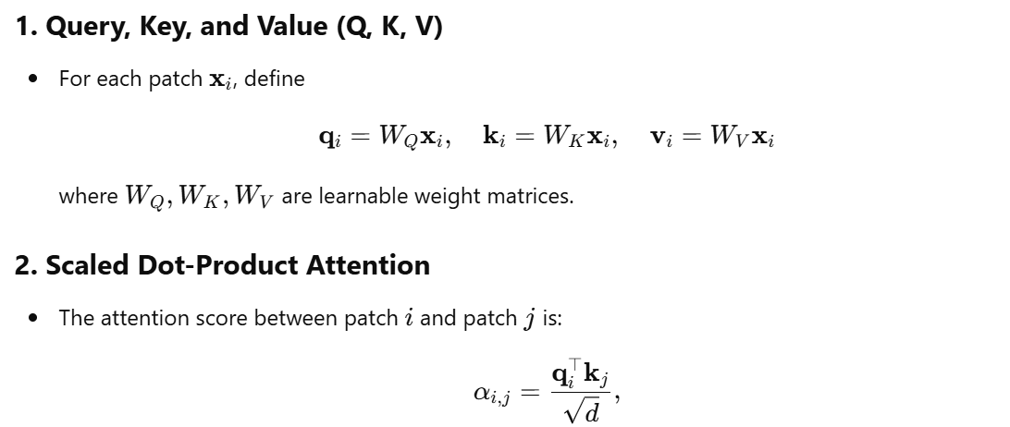
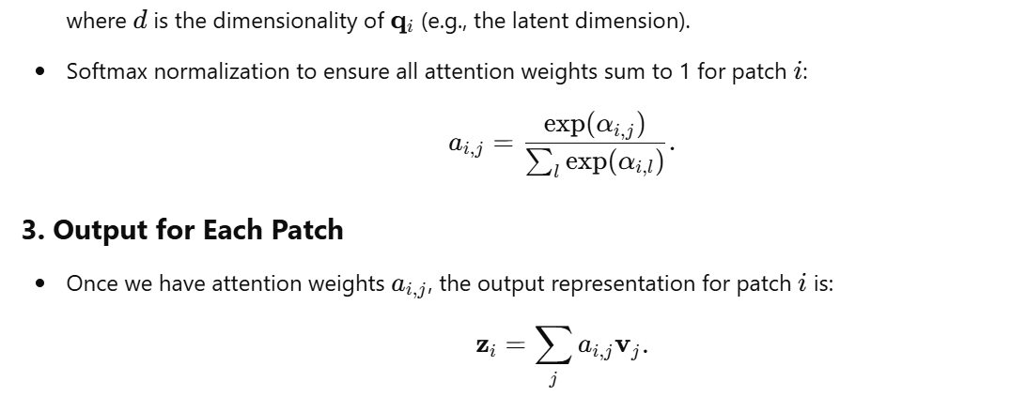

Slide 45
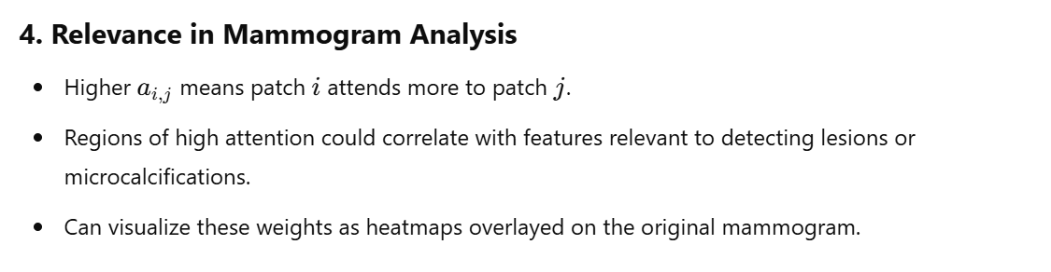
Instead of treating the whole image uniformly, the model computes attention weights that indicate which regions (or patches) are more important for the current inference. It’s analogous to how a radiologist might scan an X-ray but pay extra attention to a suspicious spot – the model learns to do this focusing by itself.
[Reference: Vaswani, A., Shazeer, N., Parmar, N., Uszkoreit, J., Jones, L., Gomez, A. N., ... & Polosukhin, I. (2017). Attention is all you need. Advances in neural information processing systems, 30.]

Slide 46
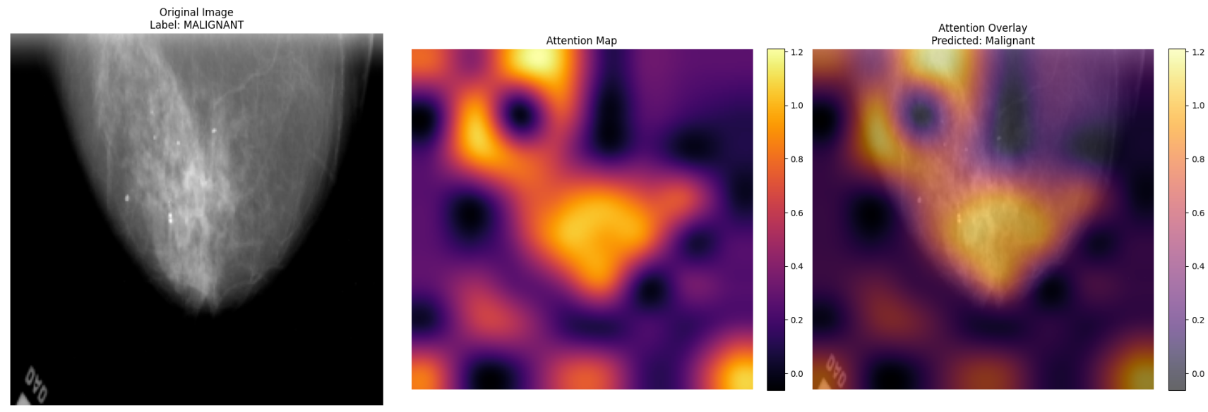
Attention Visualization

Slide 47
Practical Applications of Explainability
Informed Model Selection
Facilitates choosing models or designing architectures that align best with clinical needs.
Helps clinicians identify if a model relies on confounding artifacts or genuine pathology cues.
Robust Training and Fine-Tuning
Explanation methods can pinpoint weaknesses in the model’s learned representations.
Guides data augmentation or hyperparameter tuning to address misclassified or underrepresented cases.
Performance Under Noise or Adversarial Attacks
Identifies brittle spots and guides adversarial training or regularization strategies.
Enhances trust by demonstrating robust predictions even when data is imperfect or attacked.
Standardization Across Clinical Diversity
Explaining model decisions reveals if the model is overfitting to specific devices, protocols, or demographics.
Supports model “fairness” by uncovering biases or disparities in performance.

Slide 48
Future Directions
Robustness and Reliability: Improving the stability and consistency of explanations.
User-Centered Design: Developing XAI methods that are tailored to the needs of clinicians.
Quantitative Evaluation: Developing objective metrics for evaluating the quality of explanations.
Beyond Image Classification: Extending XAI techniques to other medical imaging tasks (e.g., segmentation, object detection, image registration).
Integration with Clinical Workflow: Seamlessly integrating XAI into clinical decision support systems.
Multimodal Explanations: Combining explanations from different modalities (e.g., imaging, clinical notes, lab results).

Slide 49
Adversarial examples
Adversarial examples are subtly perturbed inputs designed to fool AI models. These changes are often imperceptible to humans.
This vulnerability is a serious concern in healthcare, where incorrect diagnoses can have life-or-death consequences.

Slide 50
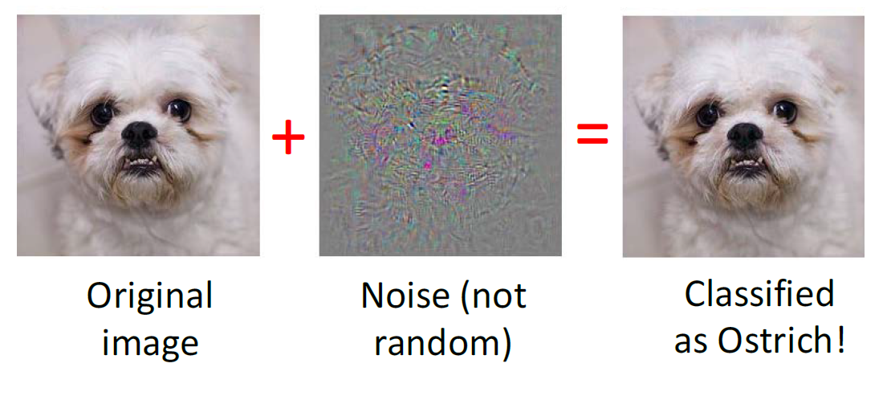
Adversarial examples
[Reference: Goodfellow, I. J., Shlens, J., & Szegedy, C. (2014). Explaining and harnessing adversarial examples.
arXiv preprint arXiv:1412.6572.]

Slide 51
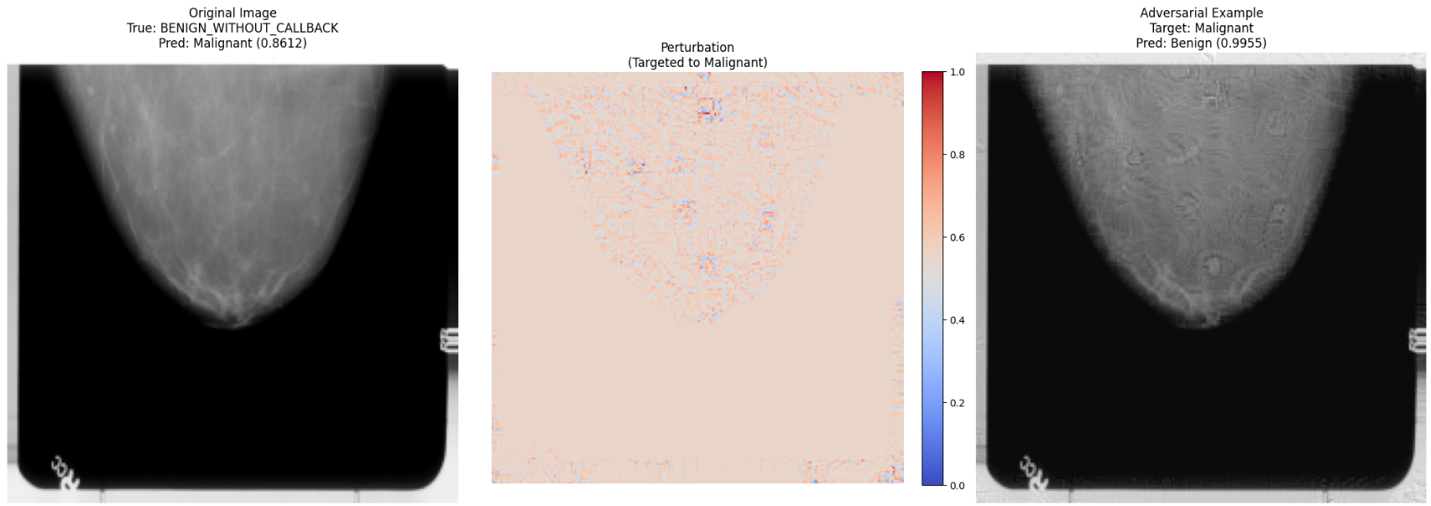
Adversarial examples

Slide 52
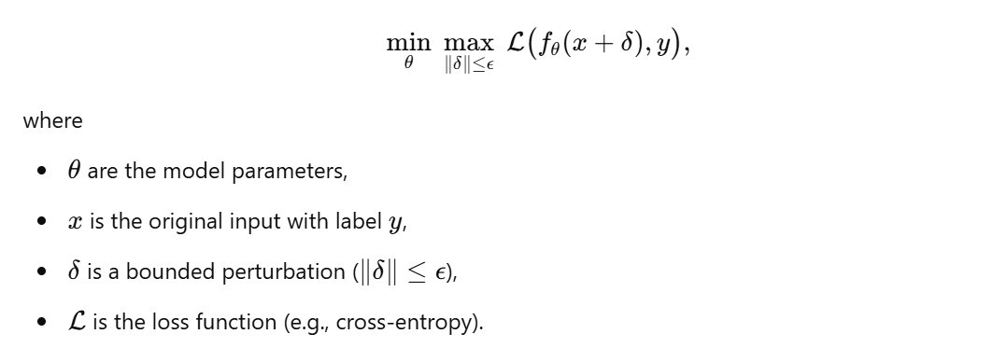
Adversarial training
Optimization Objective

Slide 53
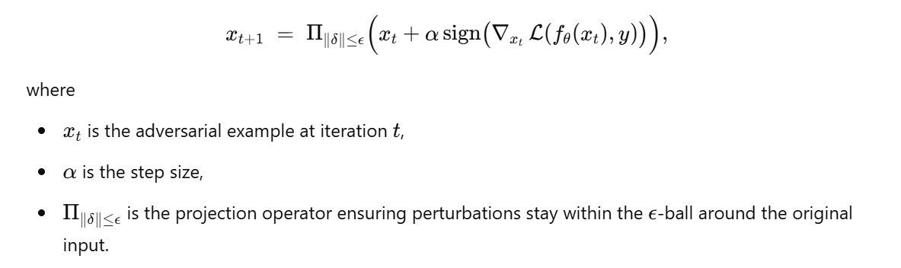
Adversarial Example Generation
Fast Gradient Sign Method (FGSM): Single-step gradient-based attack.
Projected Gradient Descent (PGD): Iterative version of FGSM, repeatedly refining the perturbation.
Both the gradient based attack methods rely on,

Slide 54
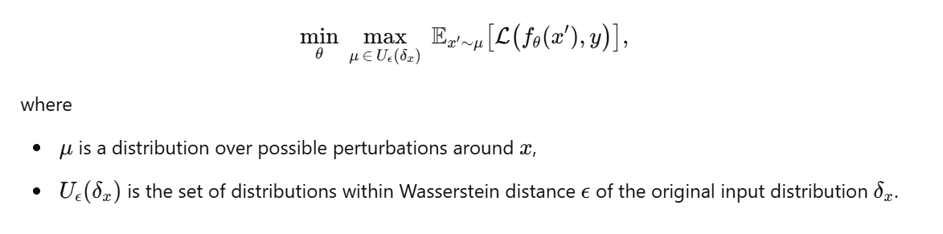
Adversarial Example Generation
Wasserstein attack focuses on perturbations measured by the Wasserstein distance (distributional robustness).
Seek adversarial distribution shifts rather than just pointwise perturbations.
Ensures robustness under broader transformations (e.g., geometric changes).

Slide 55
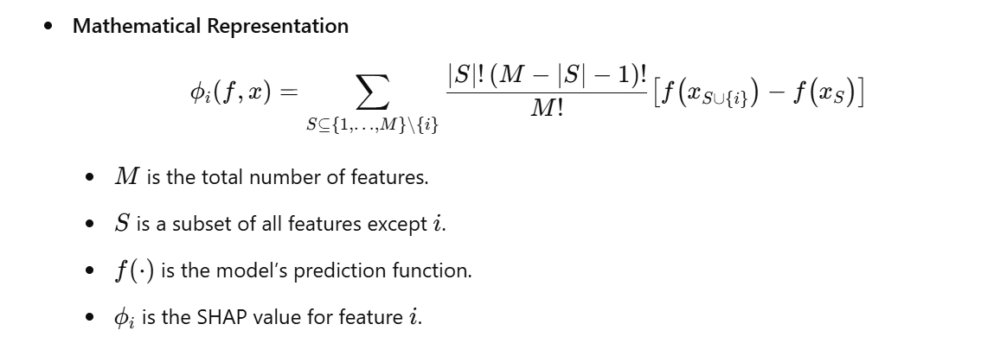
SHAP
SHAP (SHapley Additive exPlanations) is a game-theoretic approach to explain individual predictions.
Assigns each feature a Shapley value that quantifies its contribution to the prediction, averaging over all possible subsets of features.
[Reference: Lundberg, S. M., & Lee, S.-I. (2017). A Unified Approach to Interpreting Model Predictions. NeurIPS.]

Slide 56
Layerwise Relevance Propagation (LRP)
LRP backpropagates a “relevance score” from the output layer down to the input to show which input features are most responsible for a given prediction.
Steps
Forward Pass: Obtain the model’s output for a given input.
Relevance Backpropagation: Starting from the output neuron’s relevance, redistribute this relevance backwards through each layer.
Layer Rules: Specific propagation rules define how relevance flows through the network.

Slide 57
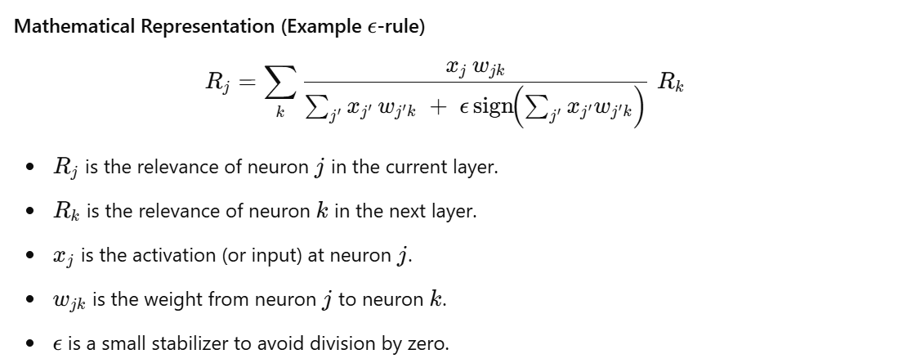
Layerwise Relevance Propagation (LRP)
[Reference: Bach, S., et al. (2015). On pixel-wise explanations for non-linear classifier decisions by layer-wise relevance propagation. PloS One, 10(7): e0130140.]

